Slide 1

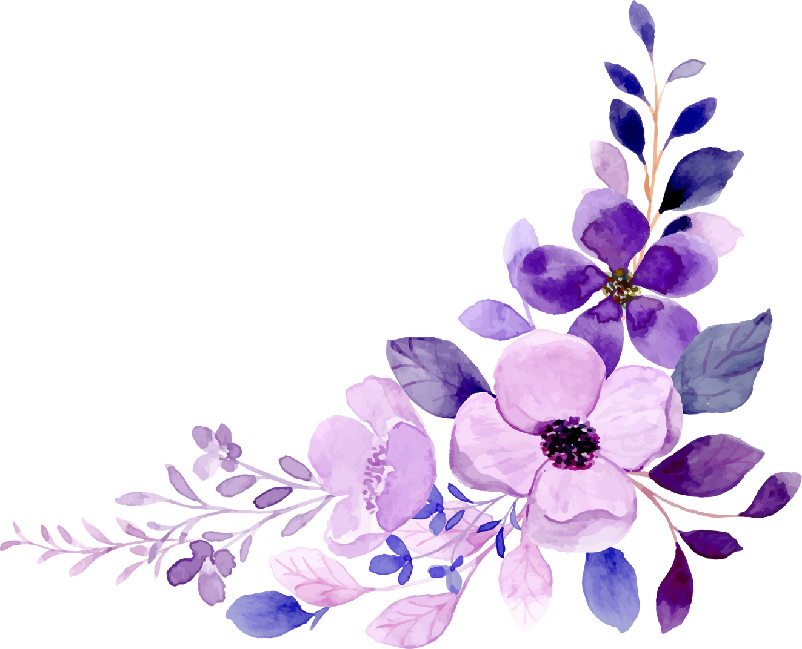
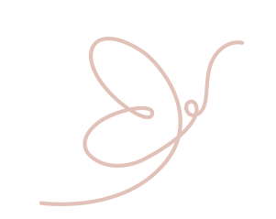
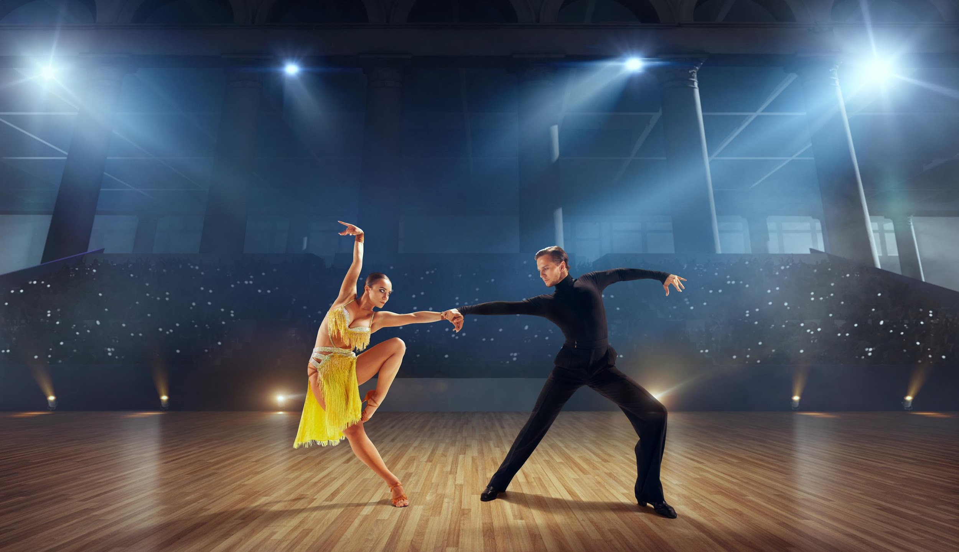
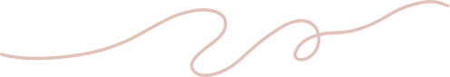
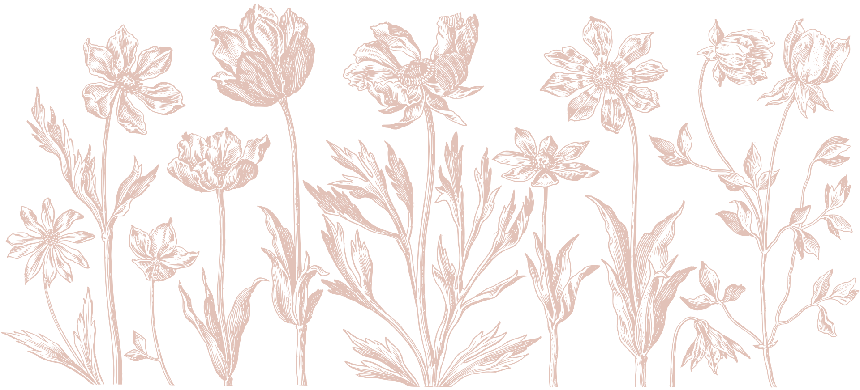
DANCE FUNDAMENTALS

Slide 2

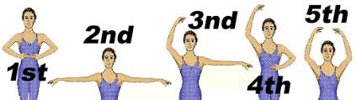





FUNDAMENTAL DANCE POSITIONS
(ARMS)
FIRST
POSITION
SECOND
POSITION
THIRD
POSITION
FOURTH
POSITION
FIFTH
POSITION

Slide 3

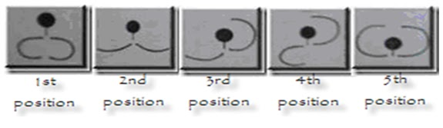
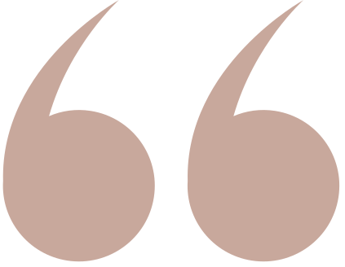
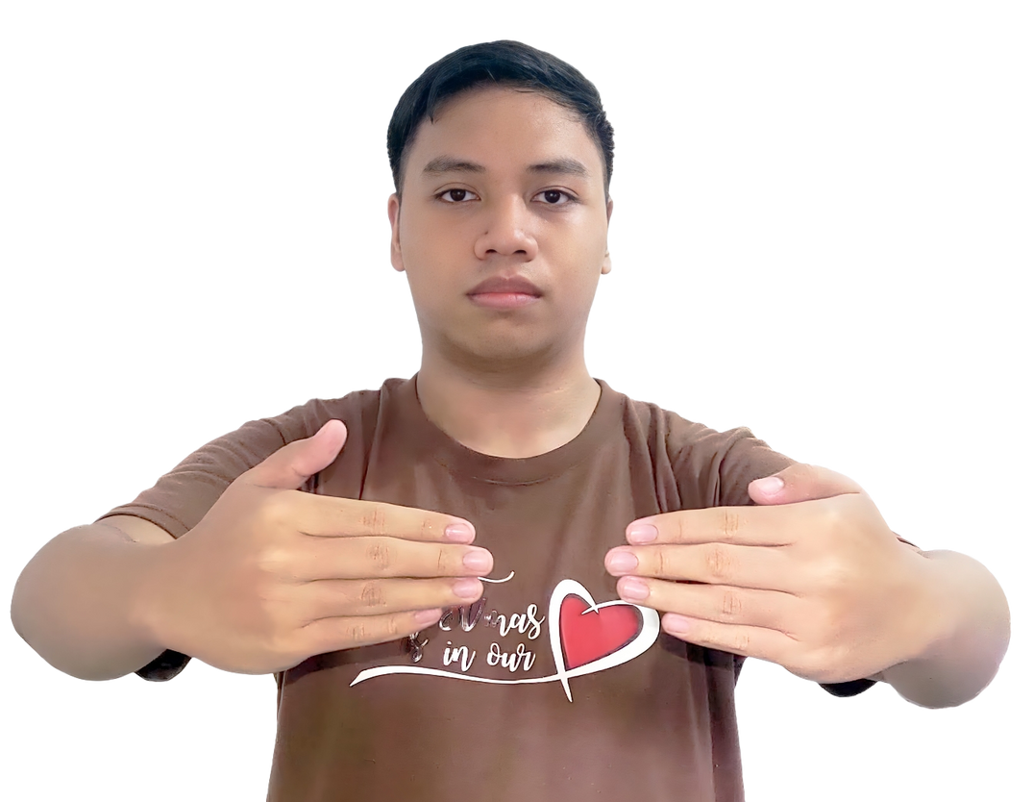

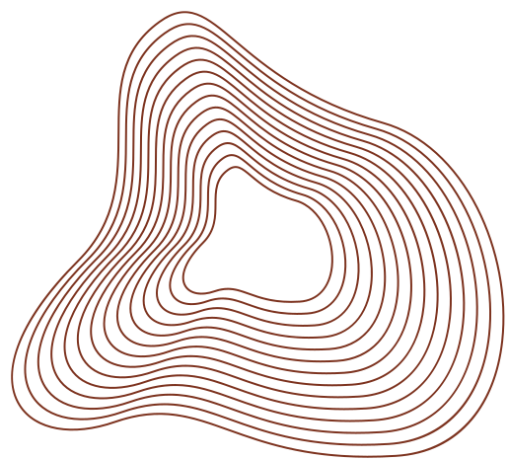
Raise arms in shoulder level to form a circle in front of chest.
FIRST POSITION
(ARM)

Slide 4

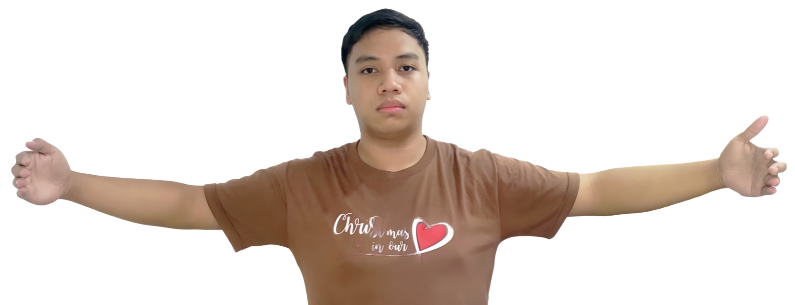
Open your arms sideward at shoulder level.
SECOND POSITION
(ARM)
pako nyo na to hshs

Slide 5
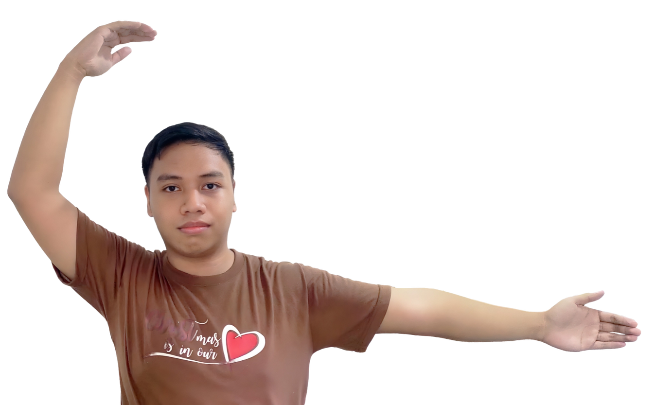

One arm is raised above your head, while the other arm maintains the second position.
The arm that was raised should be slightly curved as well.
raise above your head
THIRD POSITION
(ARM)
maintain 2nd position

Slide 6
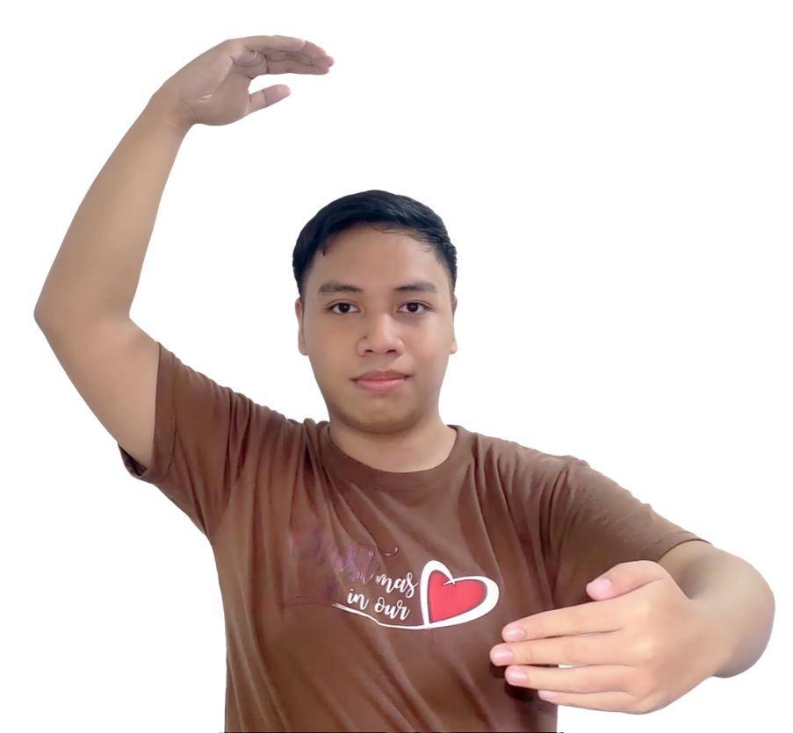
The arm in the second position would be raised forward in front of your chest again, similar to how it was in the first position.
The arm that is lifted above your head will still maintain its position.
FOURTH POSITION
(ARM)

Slide 7
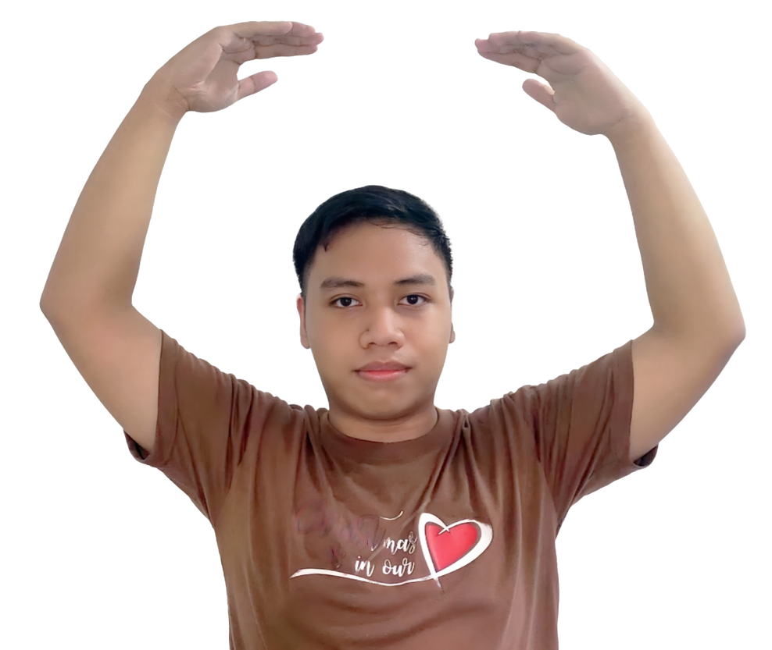
FIFTH POSITION
(ARM)
Both arms should be lifted above your head, slightly curving.
The posture is similar to that of the first position but raised above the head instead.

Slide 8
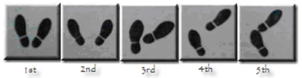
FUNDAMENTAL DANCE POSITIONS
(FEET)
FIRST
POSITION
SECOND
POSITION
THIRD
POSITION
FOURTH
POSITION
FIFTH
POSITION

Slide 9
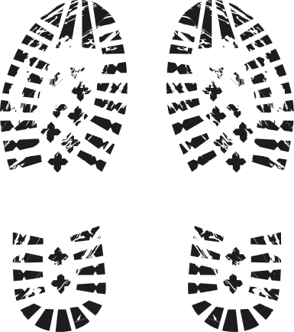
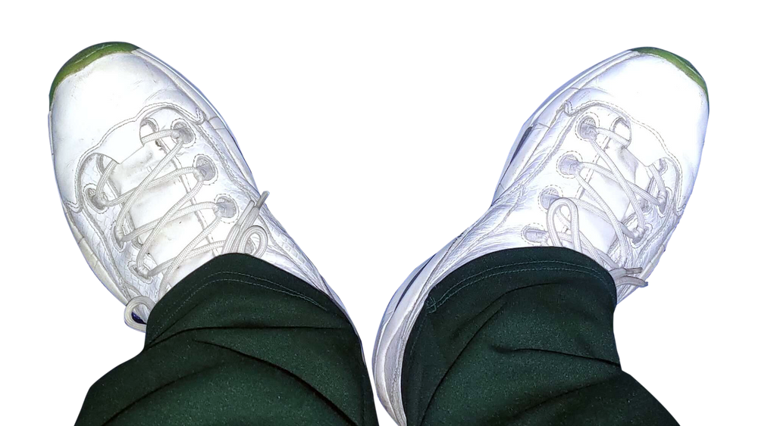
Form a V-shape with your feet by bringing your heels together to touch while keeping your toes away from each other.
(FEET)
FIRST POSITION

Slide 10
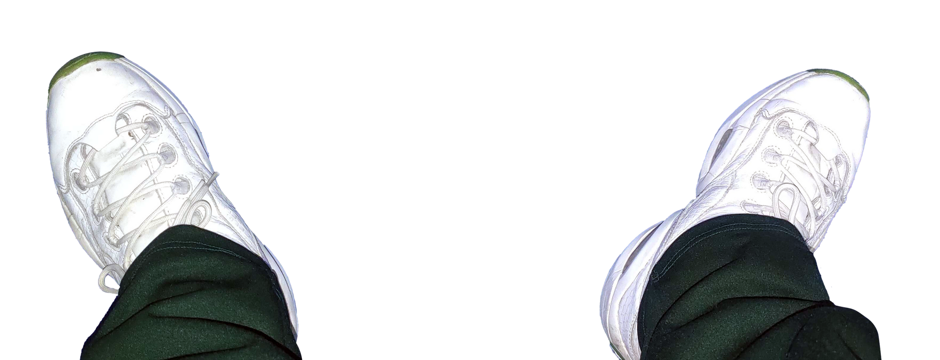
(FEET)
SECOND POSITION
Move one foot sideward. Your feet should be parallel to each other while maintaining a distance of about 12 inches.

Slide 11
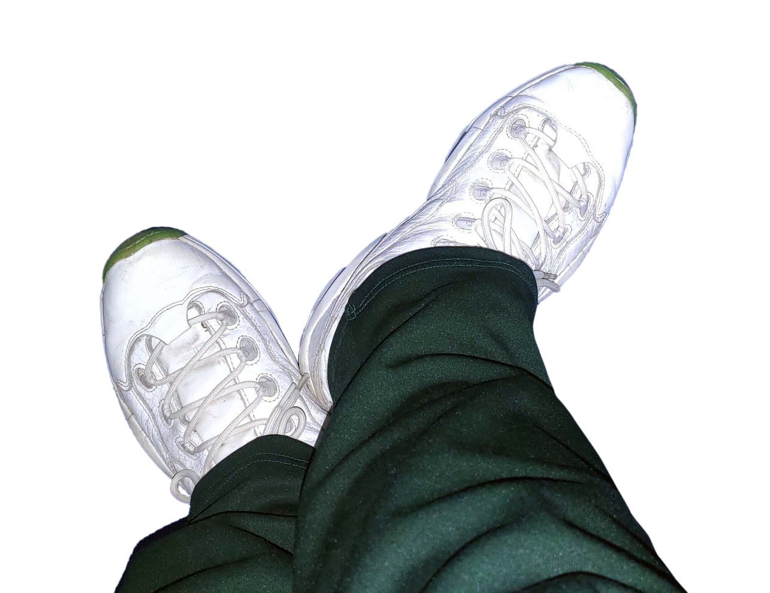
(FEET)
THIRD POSITION
Bring your foot’s heel to touch the arch of your other foot, with both feet turned outward.

Slide 12
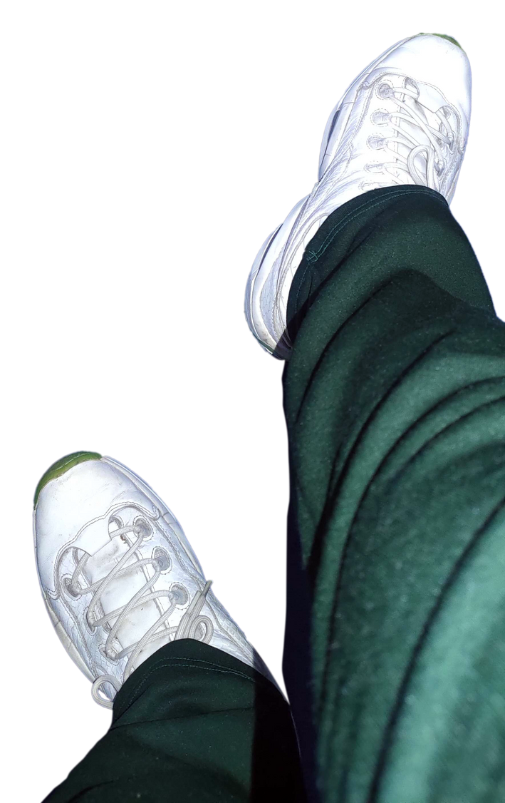
FOURTH POSITION
(FEET)
Put your foot forward while the other foot still retains its position. The distance between the two feet should be about 12 inches.

Slide 13
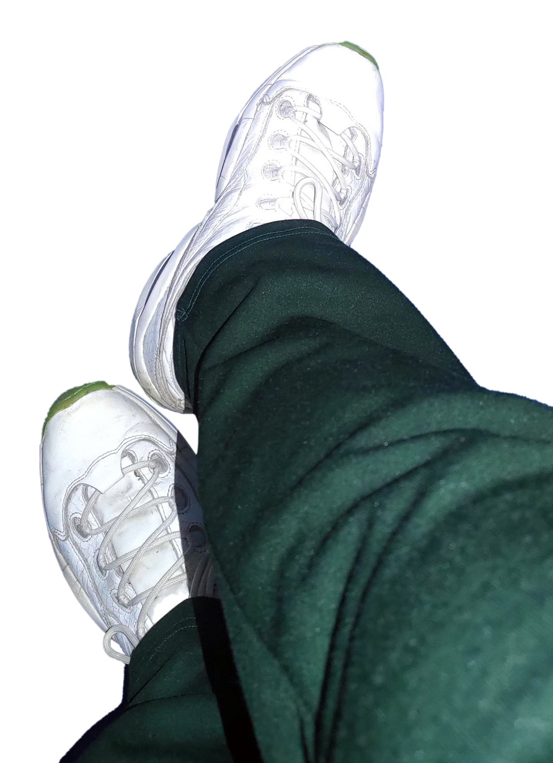
(FEET)
FIFTH POSITION
Bring the heel of the foot in front to touch the toe of the other. Both feet should still be pointing outward.

Slide 14


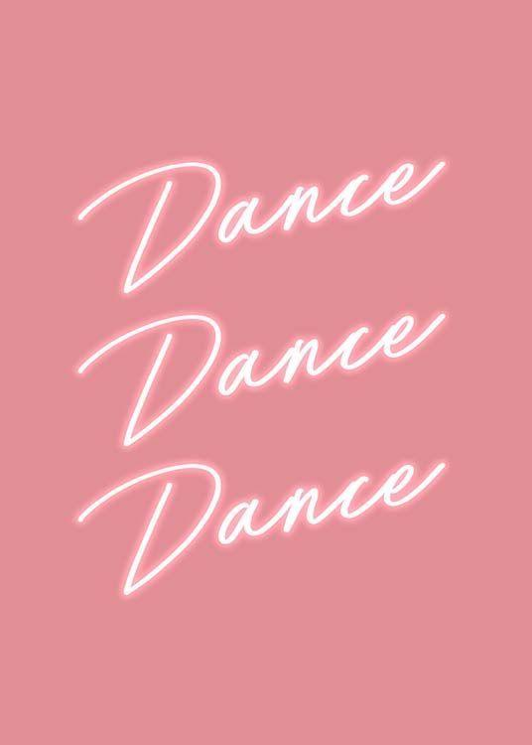
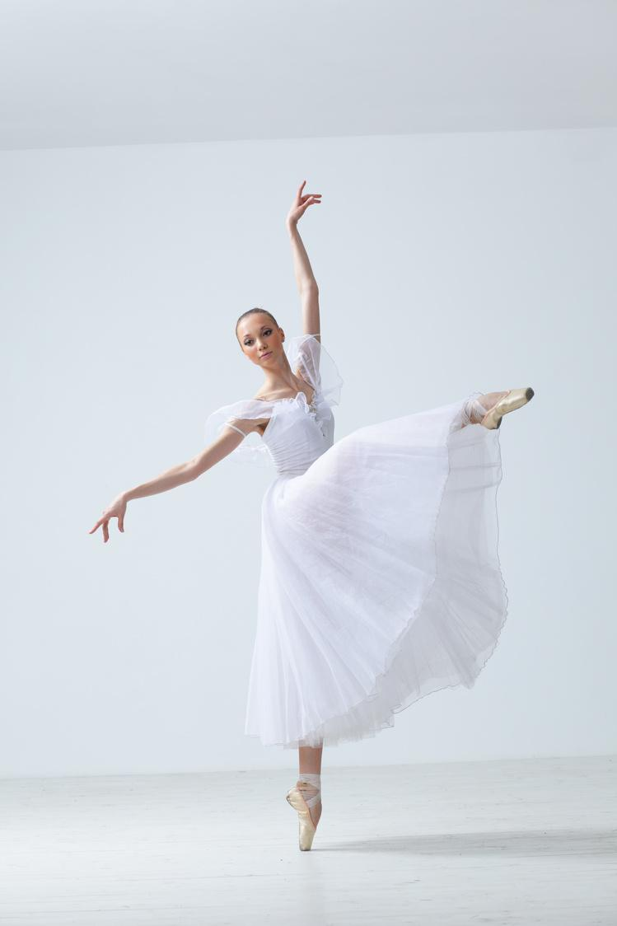
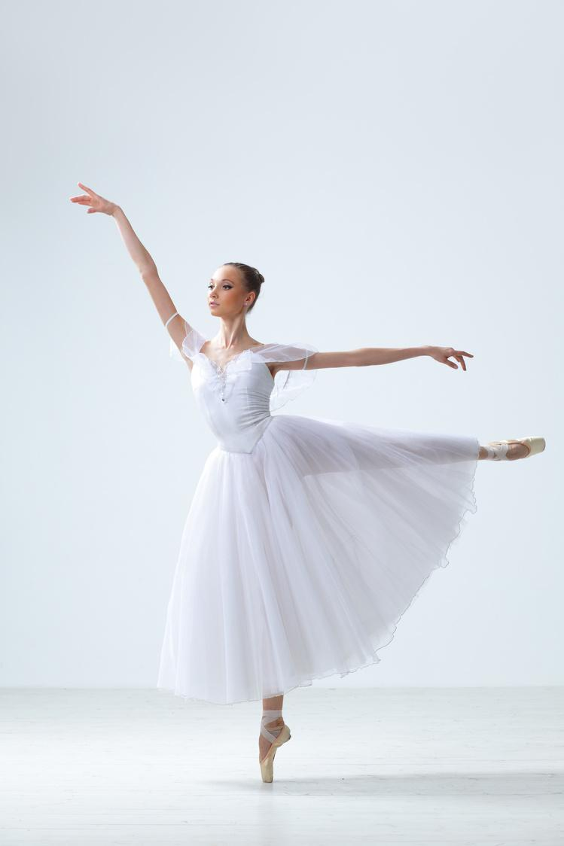
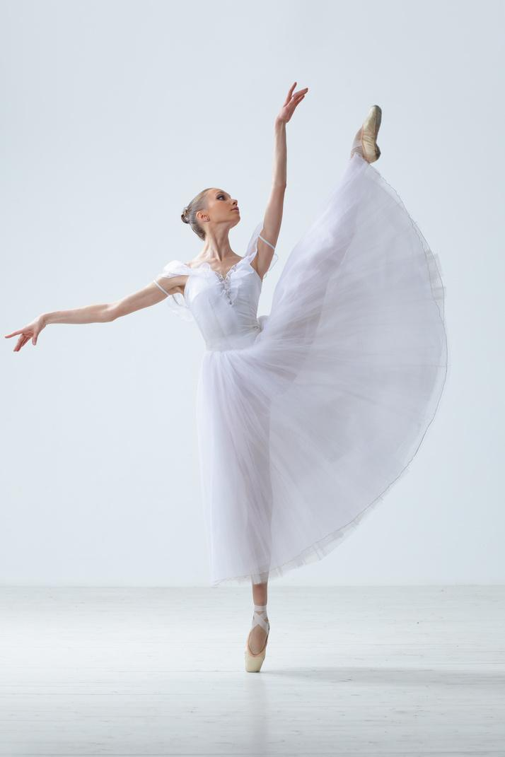
DANCE STEPS
TIME SIGNATURE
STEP PATTERN
COUNTING

Slide 15
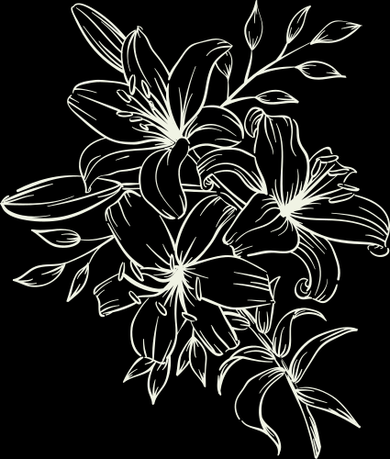
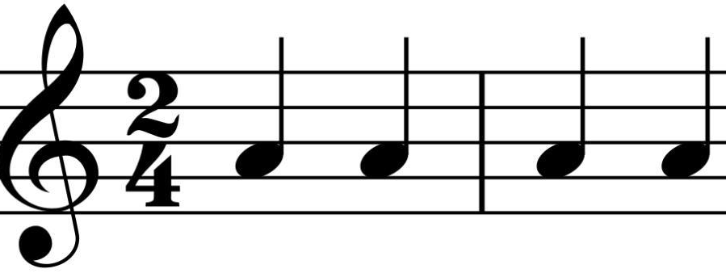
2/4 Time Signature
It's a lively time signature that's particularly popular in polkas, marches, and other dance music genres. 2/4 means there are 2 beats in each measure and a quarter note receives one count. 2/2 means there are 2 beats in each measure and a half note receives one count.

Slide 16
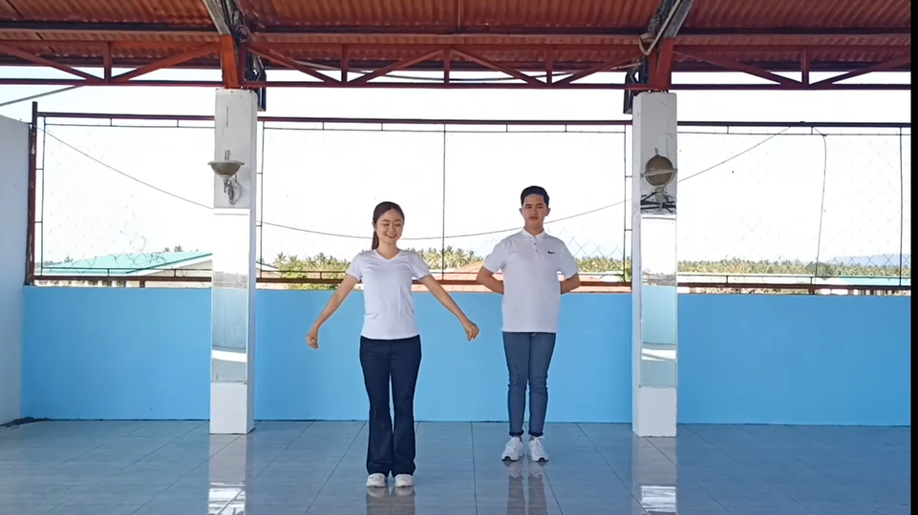
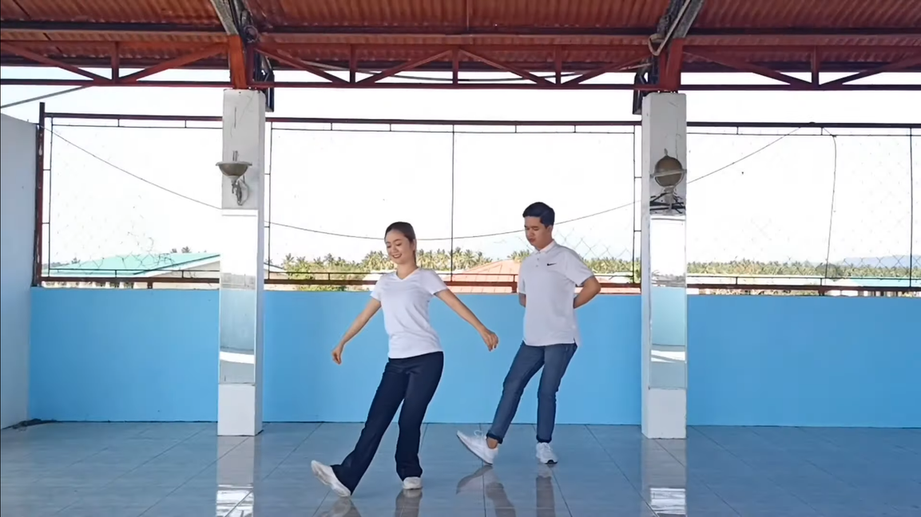
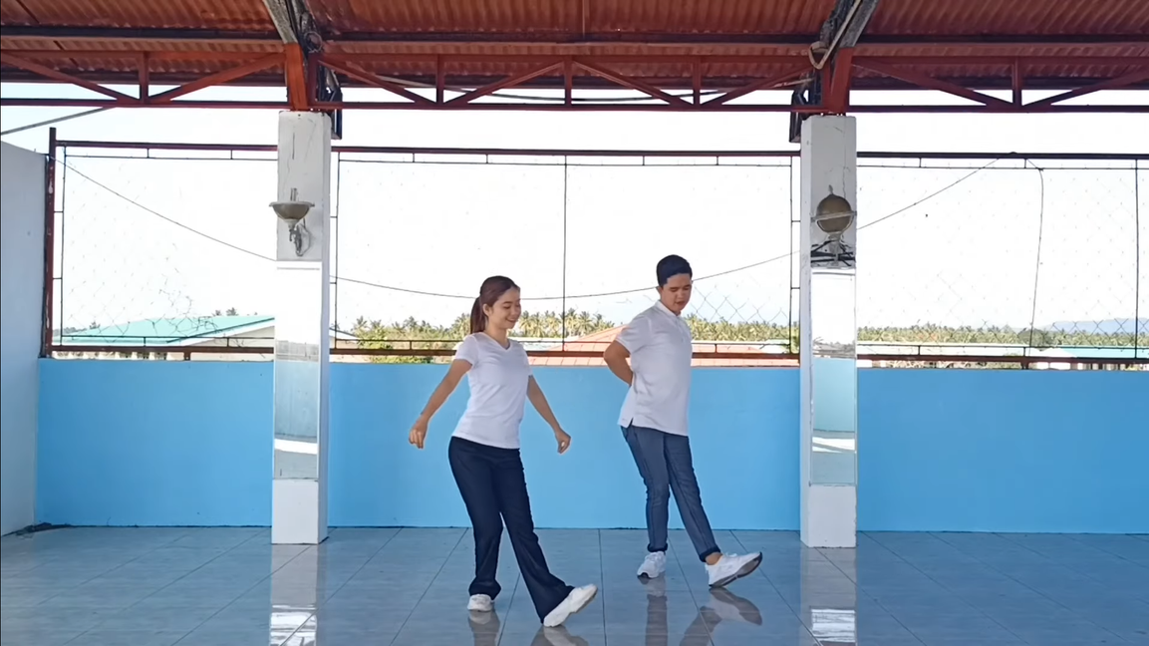
Bleking Step
2/4 time signature and
1,2 counting
Step 1
Step 2
Step 1: Close feet or first position.
Step 2: Heel place right foot.
(considered as count 1)
Step 3: Close left foot to right foot. (considered as count 2)
Step 4: Repeat the process with other foot.
Step 3
Step 4

Slide 17
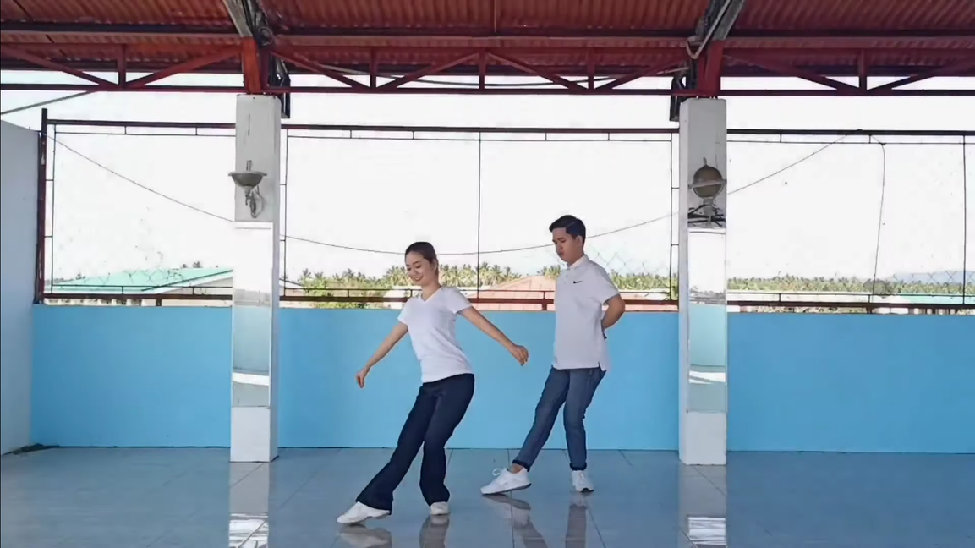
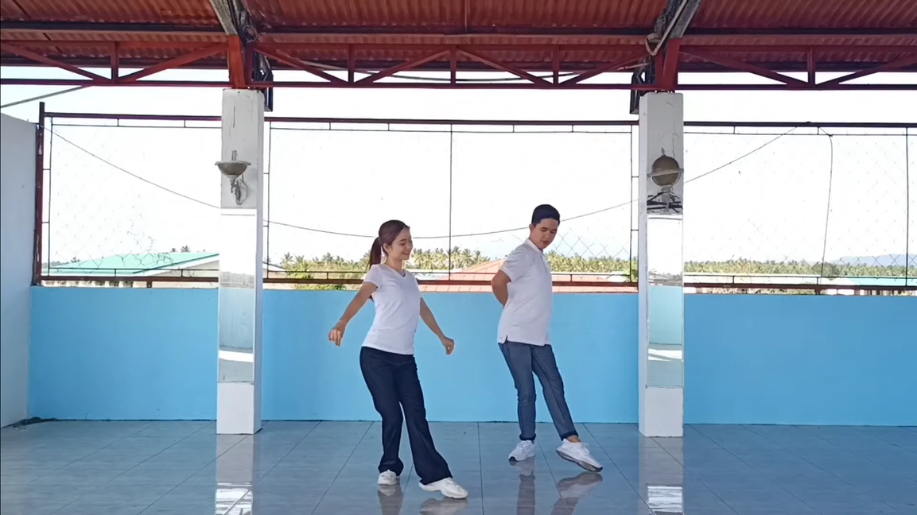
Dance Steps
Touch Step
2/4 time signature and
1,2 counting
Step 1
Step 2
Step 1: Close feet or first position.
Step 2: Point right foot.
(considered as count 1)
Step 3: Close right foot to left foot.
(considered as count 2)
Step 4: Repeat the process with other foot.
Step 3
Step 4

Slide 18
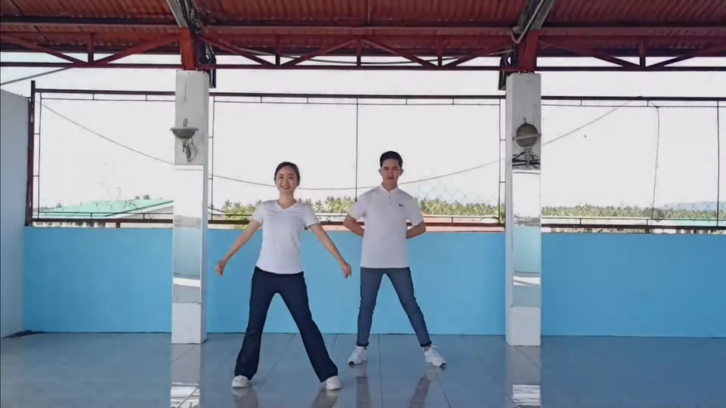

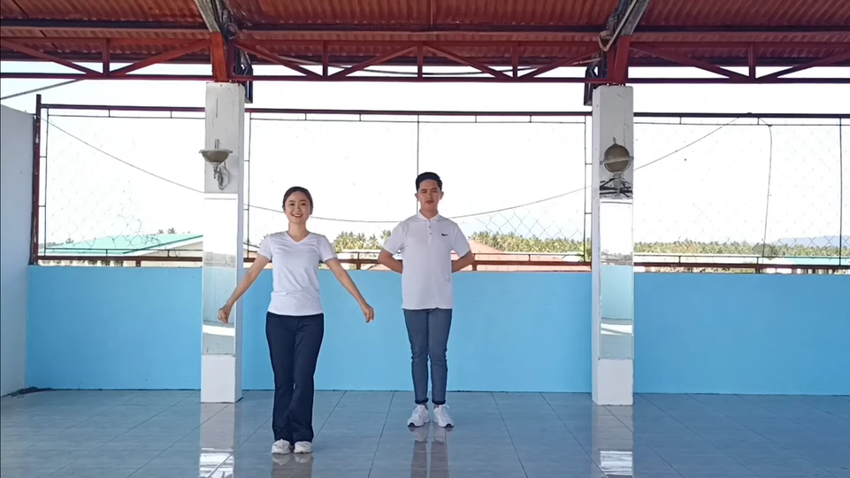
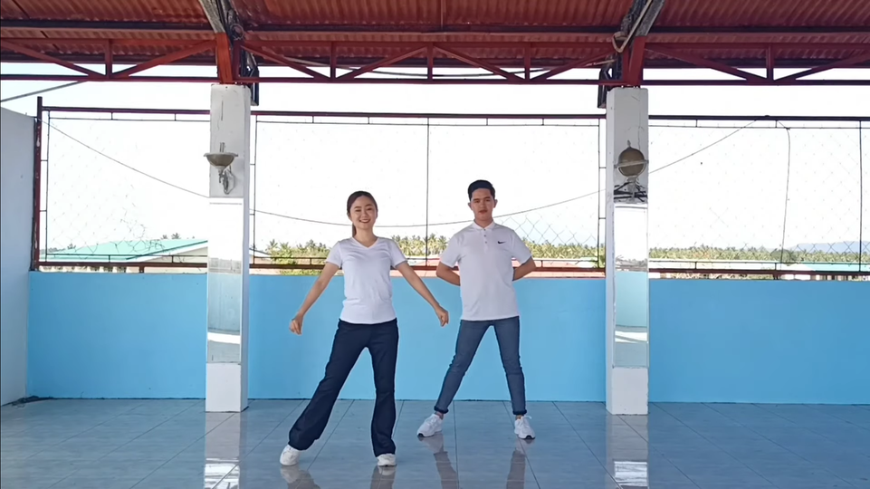
Dance Steps
Dance Steps
Close Step
2/4 time signature and
1,2 counting
Step 1
Step 2
Step 1: Close feet or first position.
Step 2: Step right foot (any direction).
(considered as count 1)
Step 3: Close left foot to right foot.
(considered as count 2)
Step 4: Repeat the process with other foot.
Step 3
Step 4

Slide 19
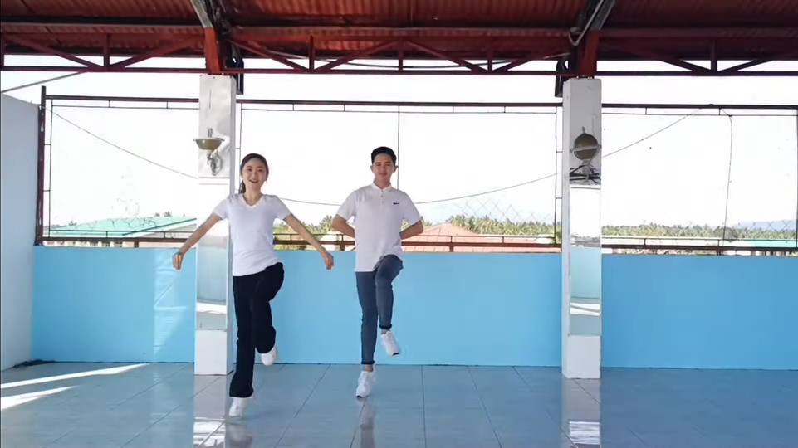
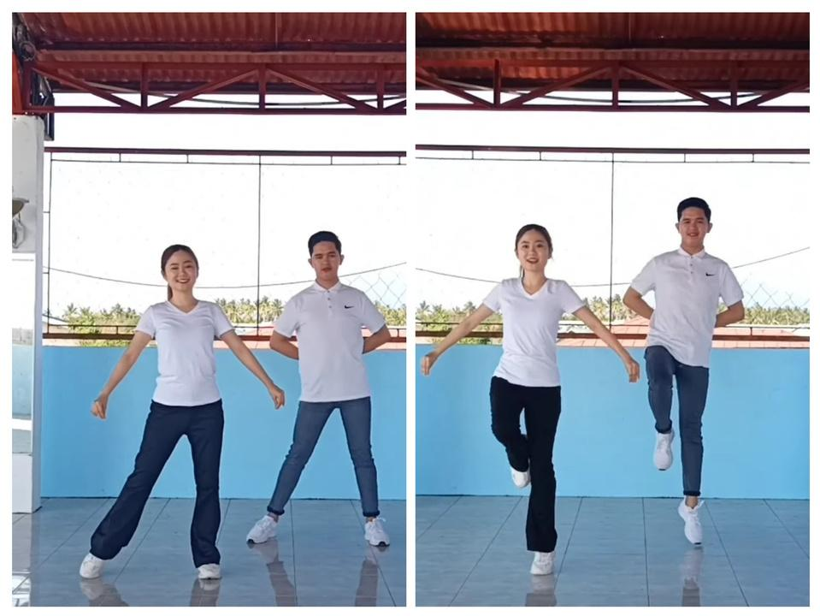
Dance Steps
Dance Steps
Hop Step
2/4 time signature and
1,2 counting
Step 1
Step 2
Step 1: Close feet or first position.
Step 2: Step right foot (any direction).
(considered as count 1)
Step 3: Hop from the left foot to the right foot. (considered as count 2)
Step 4: Repeat the process starting to step 2 with other foot.
Step 3
Step 4

Slide 20
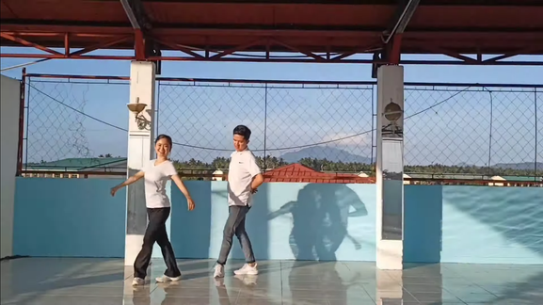
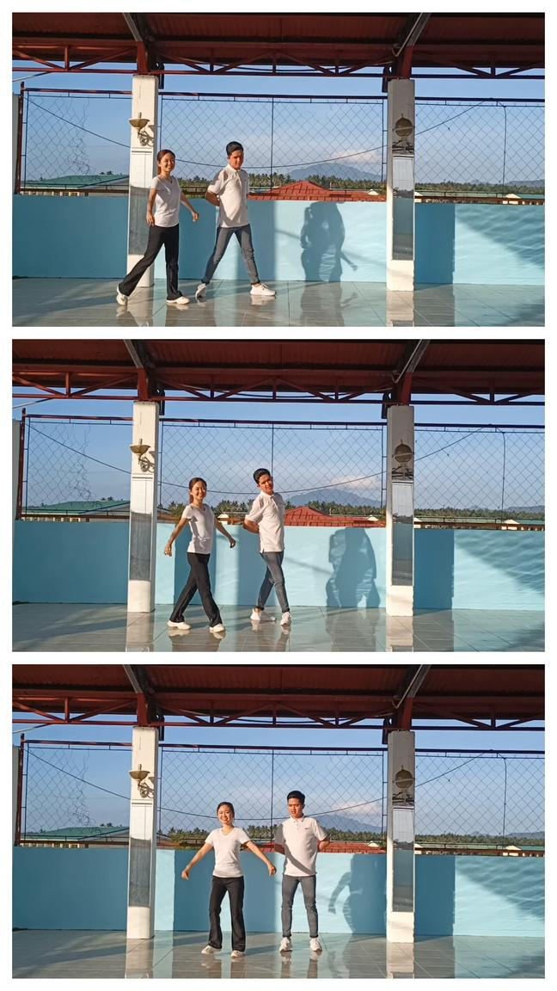
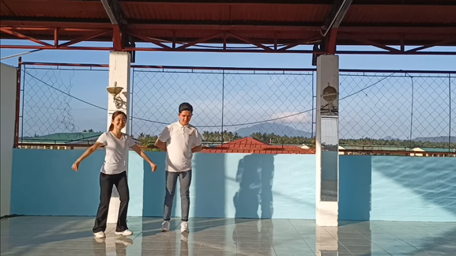
Dance Steps
Cross Step
2/4 time signature and
1,2 counting
Step 1
Step 2
Step 1: Close feet or first position.
Step 2: Step right foot.
(considered as count 1)
Step 3: Cross and step left foot to the right foot. (considered as count 2)
Step 4: Repeat the process with other foot.
Step 3
Step 3
Step 4

Slide 21
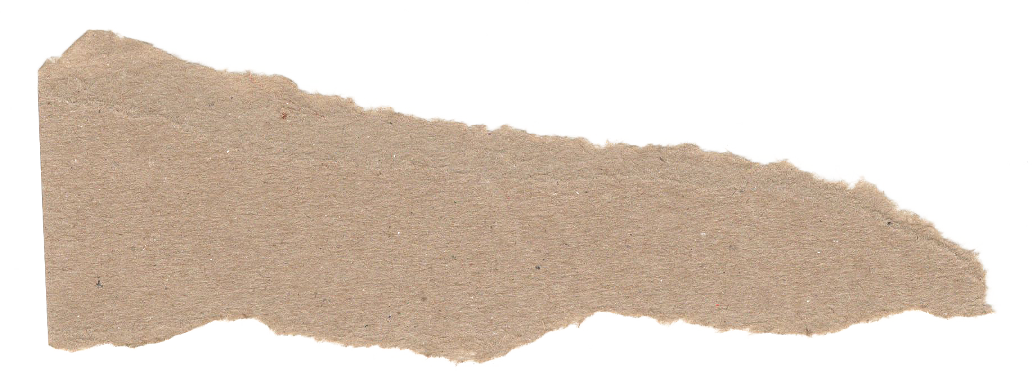


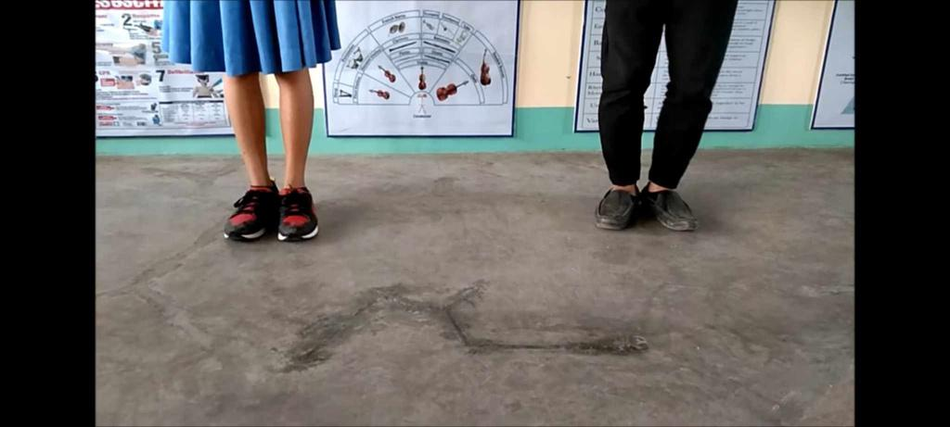
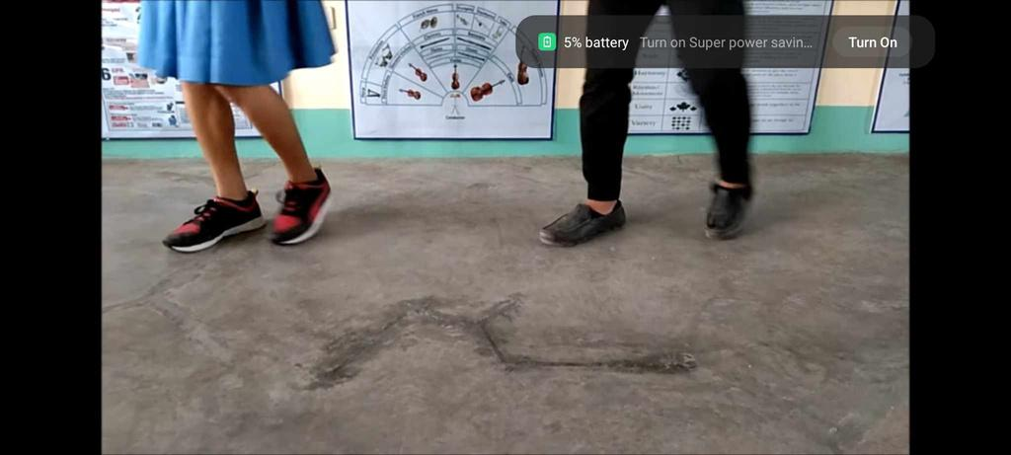


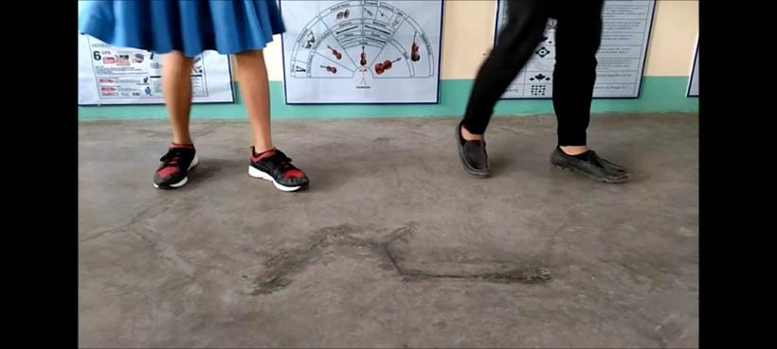
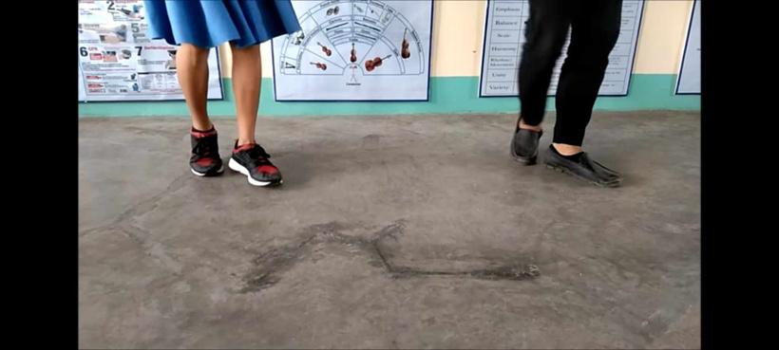
CHANGE STEP
A change-step is a step in which the weight is transferred from one foot to the other while pausing momentarily in between.
STEP PATTERN
1.Step
2.Close
3.Step
COUNTING
1 and 2

Slide 22
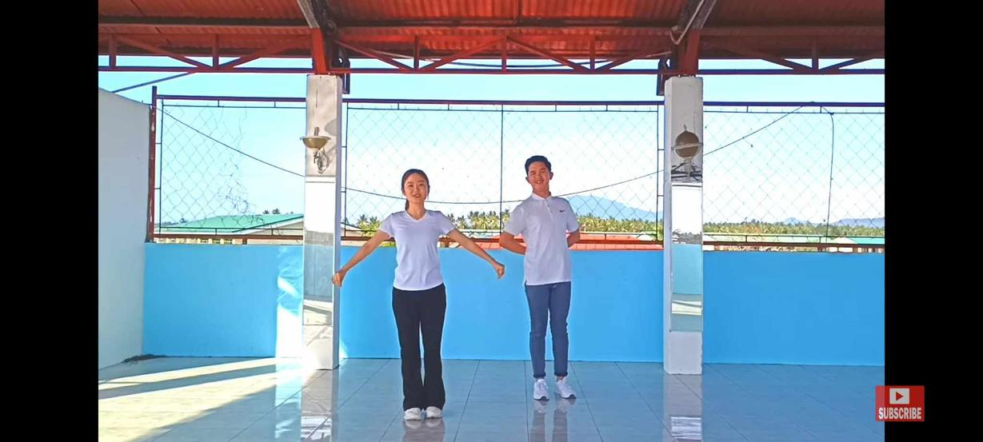
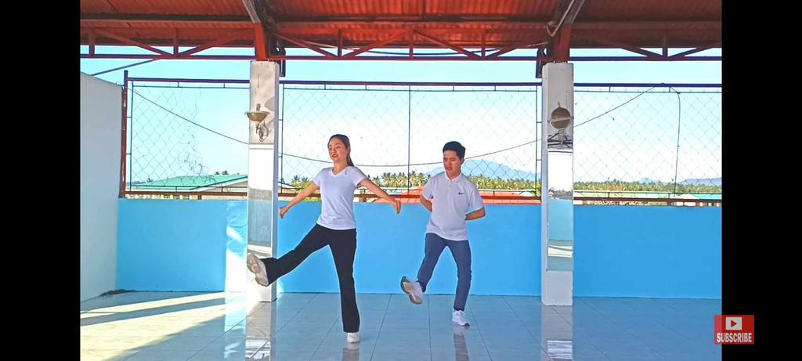
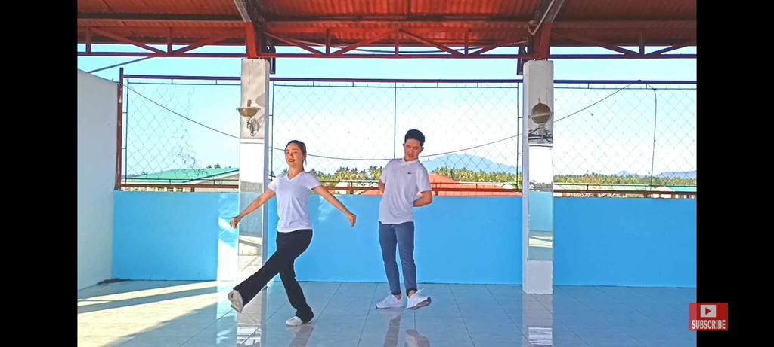

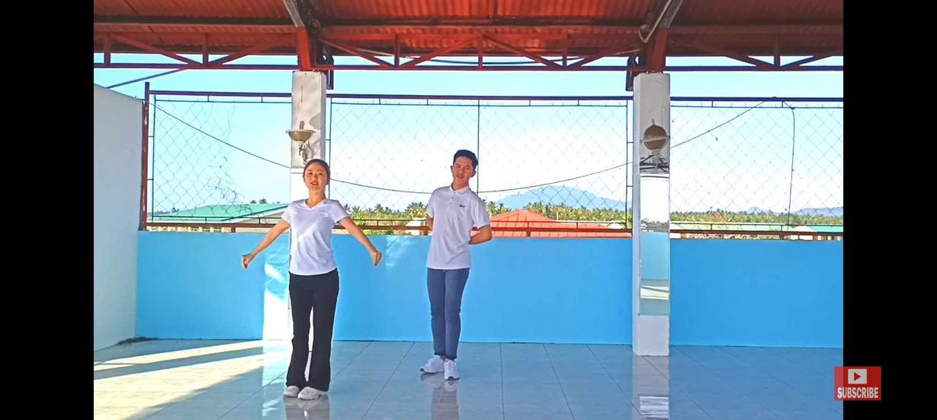
CONTRAGANZA STEP
A change-step is a step in which the weight is transferred from one foot to the other while pausing momentarily in between.
STEP PATTERN
leap foot to sideward right;
cross and step left foot across
right foot; step right foot
COUNTING
1 and 2

Slide 23
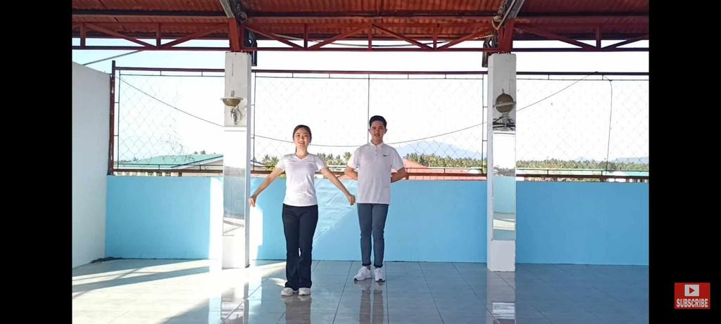



HABANERA STEP
A traditional dance that has its roots in Cuba is the habanera. It is also referred to as a danza or a habanera danza. Habanera botolena have a flamenco touch in it
STEP PATTERN
step right foot any direction;
close left foot to right foot;
step right foot in place
COUNTING
1 and 2

Slide 24






HEEL AND TOE
The Seventh Step or Heel and Toe Step, performed in a dance known as the Jig, is the first definition of heel and toe.
STEP PATTERN
heel place right in front, toe-
point in rear, step right,
close left to right, step right forward
COUNTING
1, 2 , 1 and 2

Slide 25



Change-Step, Heel-Place and Toepoint
Step Pattern
Heel-place
Toepoint
Step
Close
Step
Change-Step
Change-Step is a step that involves moving the weight from one foot to the other, with a slight pause in between.
Counting
Heel-place and Toepoint
1, 2, 1 and 2
Heel-place and Toepoint is a step that involves placing the heel of your foot on the ground, then pointing your toes.

Slide 26






Slide 27
Shuffling
Step Pattern
Both feet flat on floor
Take tiny slides steps
The shuffling dance step is a basic step in the shuffle dance style. It is a combination of two movements: a hop and a slide.
Counting
The shuffling dance step can be done in place or while moving forward or backward. To move forward, simply continue to hop and slide your feet forward. To move backward, simply continue to hop and slide your feet backward.
1 and, 2 and

Slide 28



Slide 29


3/4 TIME DANCE STEPS
A 3/4 dance step is a type of dance step that is performed in a 3/4 time signature. This means that there are three beats in each measure, and each beat is equal to one quarter note.

Slide 30
Step Pattern
Native Waltz
Step
Close
Step
Native waltz is a type of waltz that is believed to have originated among Native American tribes in the Great Plains region of the United States. It is a lively and energetic dance that is characterized by its quick steps and intricate footwork.
Counting
1, 2, 3

Slide 31




Slide 32
Step Pattern
Cross Waltz
Cross-step
Close
Step
Cross waltz is a basic dance step in the waltz. It is a step that involves crossing one foot over the other, and then stepping forward with the other foot.
Counting
1, 2, 3

Slide 33




Slide 34
Step Pattern
Waltz Balance
Step
Close-heels raise
Heel down
The waltz balance step is a basic step in waltz dancing. It is a step that involves stepping forward with one foot, closing the other foot behind it, and then raising both heels off the ground.
Counting
1, 2, 3

Slide 35




Slide 36
Step Pattern
Mazurka Step
Slide
Cut
Hop
The mazurka step refers to a specific dance step used in the mazurka, a traditional Polish folk dance. The mazurka is known for its lively and rhythmic character, often danced in triple meter. The mazurka step involves a series of movements that are executed in sync with the music's rhythm
Counting
1, 2, 3

Slide 37



Mazurka Step

Slide 38
Step Pattern
Redoba Step
Slide
Cut
Cut
The "Redoba" step, also known as "Redowa" or "Redova," is a dance step and a dance itself that originated in the mid-19th century in Bohemia (present-day Czech Republic). It became popular in Europe and was eventually adopted into ballroom dance styles. The Redoba step involves a sliding or gliding movement, often danced in a closed ballroom dance position.
Counting
1, 2, 3

Slide 39



Redoba Step

Slide 40
Sway Balance
with a point
Step Pattern
Step
Cross-step
Step point
Sway balance with a point is a movement sequence where the dancer shifts their weight from side to side in a swaying motion while extending one leg to point the toes. This combination of movements emphasizes both balance and grace, commonly seen in ballet and other dance styles where fluidity and controlled movement are essential.
Counting
1 2, 3/ 1, 2 3

Slide 41



Sway Balance
with a point

Slide 42
Sway Balance
with a hop
Step Pattern
Step
Cross-step
Step
Hop
Sway balance with a hop is a term used in dance to describe a movement that involves shifting weight from one leg to the other in a swaying motion, followed by a hop on one foot. This type of movement is commonly found in various dance styles, including ballet and contemporary dance.
Counting
1 2, 3/ 1, 2 3

Slide 43



Sway Balance
with a hop

Slide 44
Sway Balance
with a waltz
Step Pattern
Step
Cross-step
Step
Close
Step
Sway balance with a waltz is a dance movement that combines the swaying motion with elements of the waltz, a classic ballroom dance performed in triple time. This combination of movements can create a graceful and flowing sequence often used in choreography, particularly in partner dances like the waltz.
Counting
1 2, 3/ 1, 2, 3

Slide 45





Sway Balance
with a waltz

Slide 46
Engaño with a Waltz
Step Pattern
Step
Cross-step
Step
Close
Step
This step is found mostly in the Bicolano dances. It is similar to the sway-balance step.
Counting
1 2, 3/ 1, 2 3

Slide 47







Slide 48

4/4 Time Signature
A time signature of 4/4 means count 4 (top number) quarter notes (bottom number) to each bar. So the pulse, or beat, is counted 1, 2, 3, 4, 1, 2, 3, 4, and so on. That means all the notes in each bar must add up to 4 quarter notes.

Slide 49
Schottische
Step Pattern
Step
Close
Step
Hop (raise foot in front)
The schottische basic step is made up of two sidesteps to the left and right, followed by a turn in four steps. In some countries, the sidesteps and turns are replaced by Strathspey hopping steps.
Counting
1, 2, 3, 4,
1, 2, 3, 4

Slide 50





Slide 51
Escotis
Step Pattern
Step
Close
Step
Hop (raise foot in rear)
It is popularly known in Capiz and is performed in any social gathering of the people inhabiting the mountains of Capiz in the barrios of Tinpas and Banitan and also in the town of Panay.
Counting
1, 2, 3, 4,
1, 2, 3, 4

Slide 52


Slide 53
Chotis
Step Pattern
Brush
Raise
Brush
Raise
Step (turn)
Close
The Chotis (or “Shotis”) was one of the ballroom dances learned by the Filipinos from the early European settlers. This dance, from Camarines Sur, has been adapted by the Bicolano people and is characterized by a brush-step-hop movement.
Counting
1, 2, 3, 4,
1, 2, 3, 4

Slide 54







Slide 55

Thank you for listening!
MEMBERS:
RAMBOYONG, JHEDIAEL CALVIN T.
ORIAS, FRANXINE
CAMIQUE, JAMES IVAN
LLANES, KEVIN
WEEK 3
JULIANE, CJ
PABUA, EMANN

